Slide 1
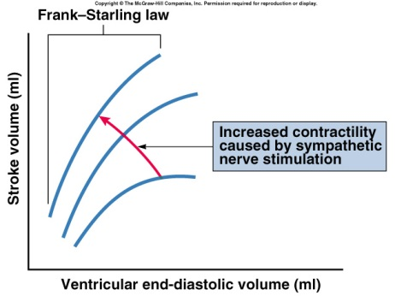
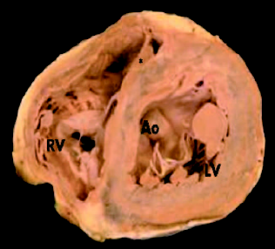
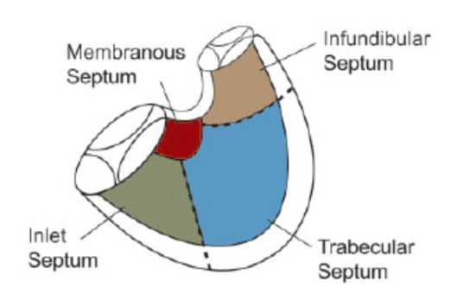
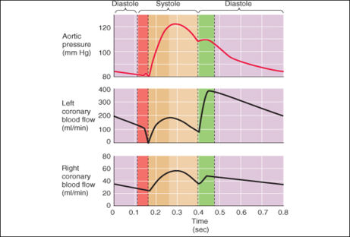
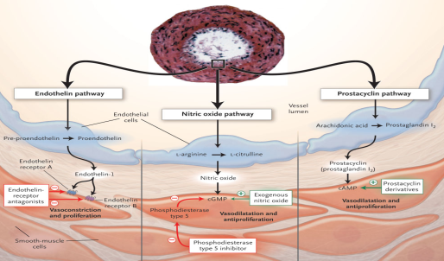

Management Of Acute Right Ventricle Failure In PAH
Rasoul Azarfarin MD, FACC
Professor of Anesthesiology,
Fellowship of Cardiac Anesthesia

Slide 2
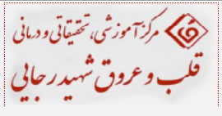
Right Ventricle
RV connected to pulmonary circulation: low pressure system
Anatomical specificities of RV: thin wall (1/3 LV), crescent shape
RV considered a passive conduit between systemic and pulmonary circulation

Slide 3
Anatomy
The RV is triangular in shape
Divided into three regions;
  Inlet
  Apex
  Infundibulum or Conus
Both Ventricles are composed of a 3D network of muscle fibers
Circulation 2008;117:1436-1448

Slide 4
Venous Return Physiology
The Heart can only pump out, what comes in. Therefore the main job of the RV is to maintain a low right atrial pressure so that Venous Return is optimized.

Slide 5
Venous Return Curves
Plateau: collapse of large veins ( => increased resistance)
Venous return with volume loading
5 L/min
Cardiac Output with increase inotropy
VR (CO)
Working Cardiac Output
-4
0
Mean systemic filling pressure ~ 7 mm Hg
Rt. Atrial Pressure (mm Hg)

Slide 6
Effect Of Ventricular Contraction
Right ventricular Contraction is sequential, starting with the inlet and ending at the infundibulum.
  Inward movement of the free wall (bellows effect)
  Contraction of the longitudinal fibers, which shortens the long axis.
  Traction of the free wall caused by contraction of the LV. (wringing effect)
Due to the compliance of the infundibulum the peak pressure is reduced and prolonged.
This leads to near complete emptying of the RV>>reduced RVEDP>>Optimal Venous return.

Slide 7
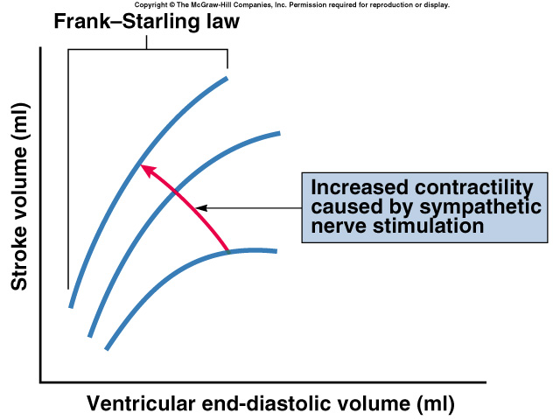
Frank-starling Law Of The Heart
States that strength of ventricular contraction varies directly with EDV
  Is an intrinsic property of myocardium
  As EDV increases, myocardium is stretched more, causing greater contraction & SV
Fig 14.2

Slide 8

Definition of RV Fialure
« The clinical syndrome resulting from the inability of the right ventricle to provide adequate blood flow to the pulmonary circulation at a normal central venous filling pressure »

Slide 9
O2 Requirements and Blood Supply to The RV
Less O2 requirements than the LV : less myocardic mass, less pre load and after load .
During stress, extraction reserve is greater.
Vascularisation : 2/3 RCA, 1/3 left branches
RV perfused in both systolic and diastolic phases as a result of the low systolic pressure (25 mmHg), which does not occlude the vessel that has a systemic pressure.
If afterload ↑, pressure necessary to contract the RV successfully ↑, partial occlusion of the RCA may occur ⇒ ischaemia.

Slide 10
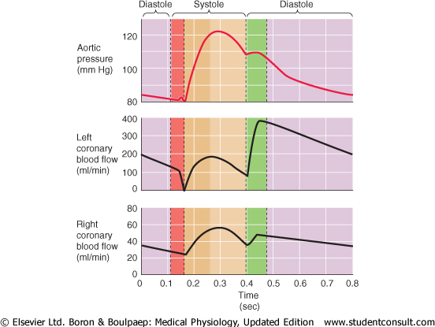
Aortic Pressure and Coronary Blood Flow

Slide 11
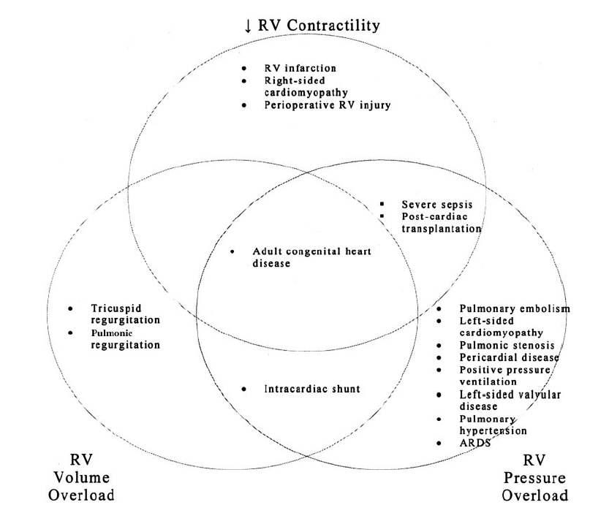
Etiologies Of Failing RV
Piazza, G. et al. Chest 2005;128:1836-1852

Slide 12
Main Circumstances In Peri-Op.
Severe pulmonary embolism
ARDS
Sepsis induced RV dysfunction
Medical conditions leading to exacerbation of chronic pulmonary hypertension
Right ventricle infarction
Pericardial diseases
RV failure after cardiac surgery
After cardiac transplant

Slide 13
Ventricular Interdependence
During systole, LV protrudes in RV
Surrounding pericardium with limited distensibility
Compliance of one ventricle can modify the other = Diastolic ventricular interaction

Slide 14
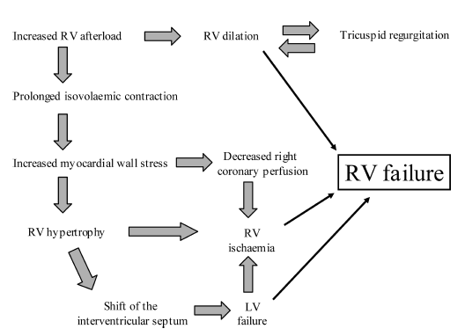
Auto-aggravation: The Vicious Cycle

Slide 15
Right To Left Shunting
Increase in RA pressure due to RVF
Reopening of patent foramen ovale
Right to left shunting
Secondary hypoxemia
Can be improved by improving RV function
Hypoxemia usually not improved by mechanical ventilation in case of RVF due to pulmonary hypertension (PAH)

Slide 16
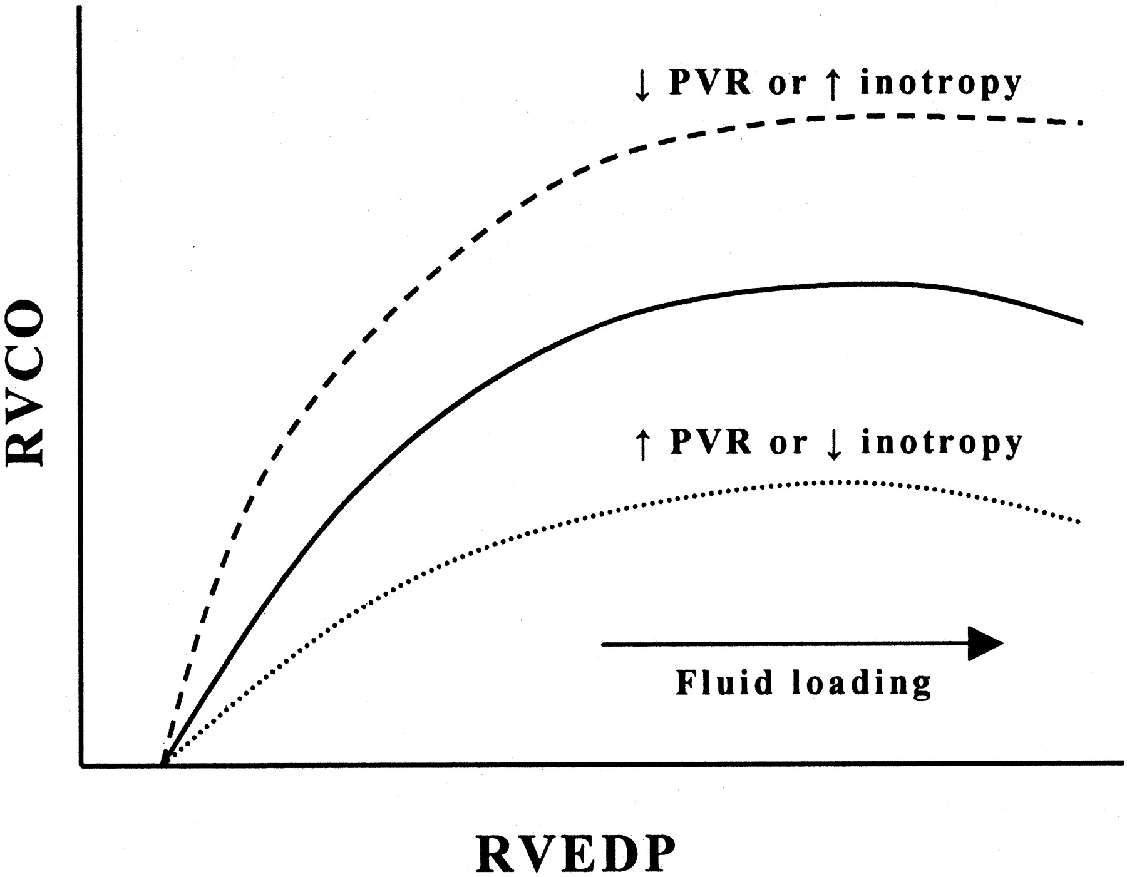
Management of RV Failure (1)
Control of trigerring factors
Supportive treatment:
  Optimization of preload
  Improving contractility
  Pulmonary vasodilators
Specific therapies addressing the cause of RVF

Slide 17
Management of RV Failure (2)
Treat the underlying cause if possible
Fluid Management
  Volume Loading or Diuresis?
Maximize Myocardial O2 Supply/Demand
  Supplemental Oxygen
  Maintaining Systemic Pressures
    Norepinephrine
    Phenylephrine
  Avoiding Tachycardia
  Blood transfusion?
Increasing Contractility
  Dobutamine
  Milrinone
  Calcium Sensitizers
RV Afterload Reduction
  Milrinone
  Nitric Oxide
  IV Prostacyclin
  Avoid Mechanical Ventilation if possible

Slide 18
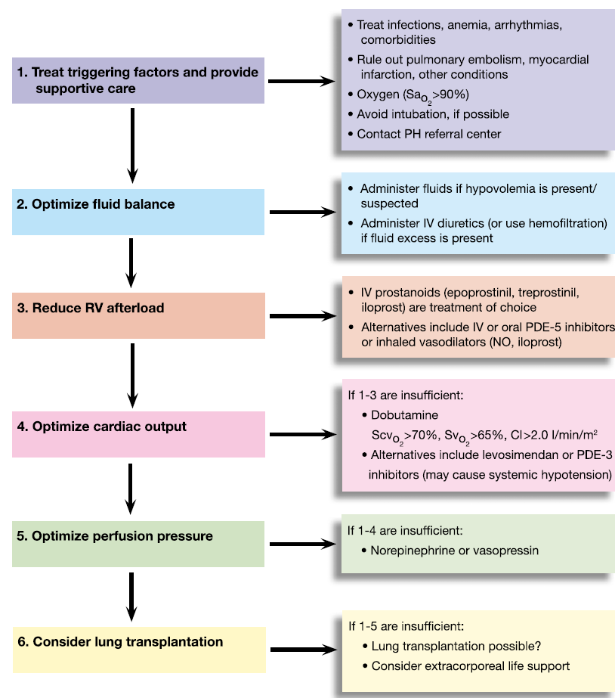
Hemodynamic Management of RV Failure In PAH

Slide 19
Anesthetic Management of RV Failure due to PAH
Treat the underlying causes of PAH exacerbation:
  Hypoxia
  Hypercarbia (maintain PaCO₂: 30-35 mmHg)
  Acidosis
  Pain
  Anxiety
Secure airway and establish mechanical ventilation if necessary (Deep sedation & Analgesia during PPV).
Provide invasive monitoring (CVP, Arterial line, PAC).
Repeated ABG Check.

Slide 20
Side effects of Mechanical Ventilation
Higher transpulmonary pressures increase RV afterload.
Increased airway pressures reduce venous return.
Increased pleural pressures are transmitted to the pericardium and limits the diastolic filling of the RV.
Chest. 2005;128:1836-1852

Slide 21
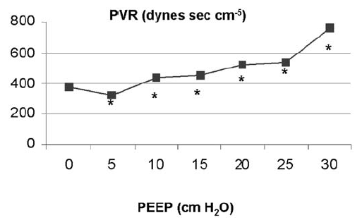
Effects Of PEEP On RV Performance

Slide 22
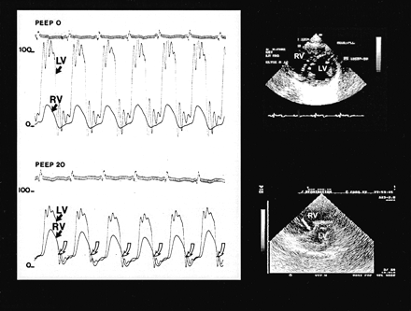
Effect of High PEEP on RV

Slide 23
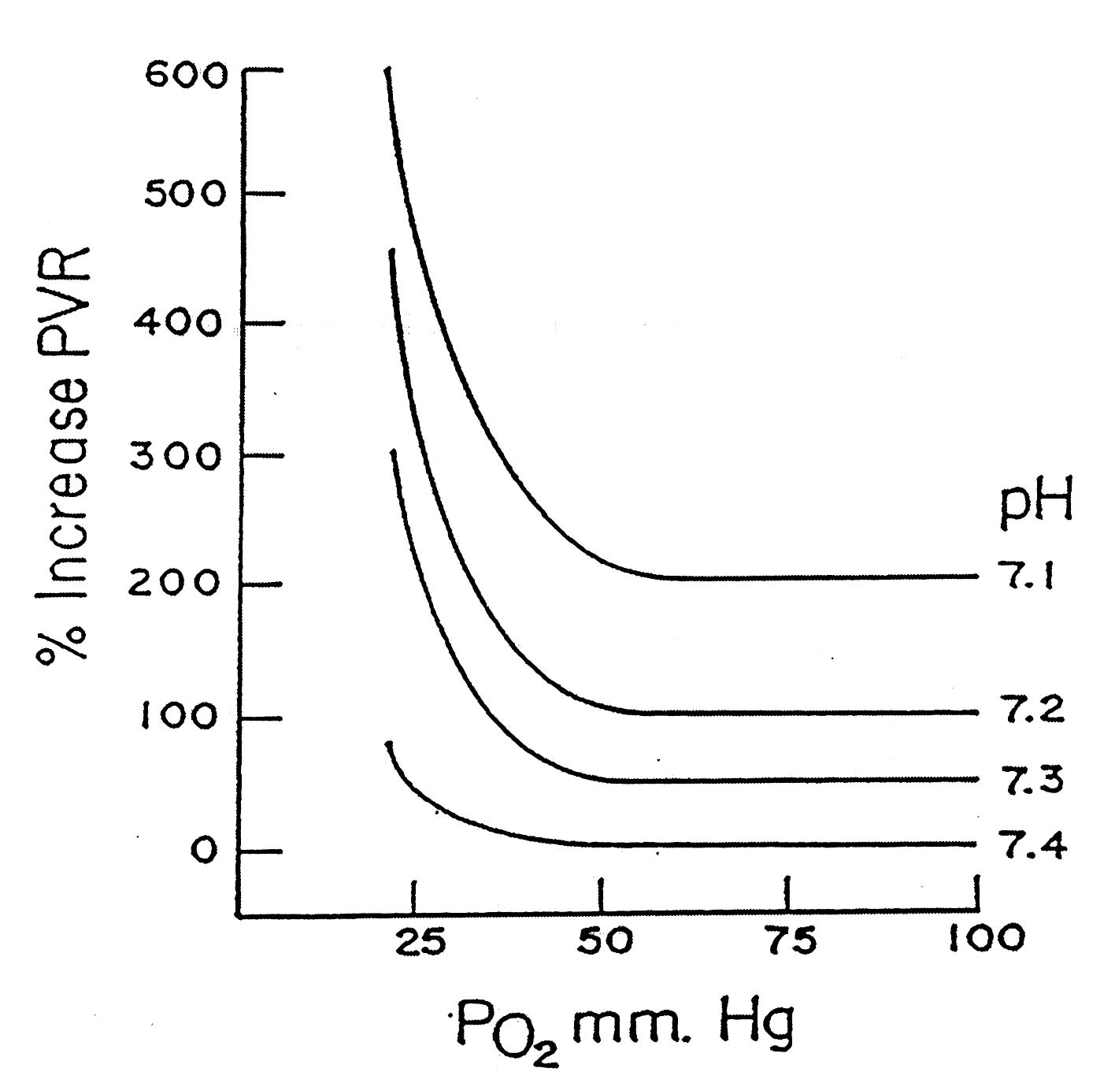
pH and PO₂ Important for PVR

Slide 24
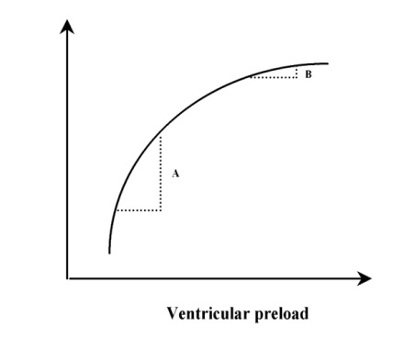
Optimization of Preload
Frank-Starling relationship between preload and stroke volume: preload dependance (A) and preload independance (B)

Slide 25
Diuretics
Frequent volume overload
At a point of Frank-Starling curve where there is no more reserve on contractility
Ventricular interdependance
Diuretics to be considered
Sometimes with continuous high dose infusion
If fails, consider Continuous Veno-Venous Hemofiltration (CVVHF)

Slide 26
Inotrops and Vasopressors Used in RV Failure

Slide 27
Dobutamine
β1 adrenergic stimulation
↑ CI ↓ PVR at 5 μg/kg/mn
At higher dose ↑ HR without subsequent ↓ in PVR
Experimental models Dobutamine > Norepinephrine to improve right-ventricular – pulmonary artery coupling
Improves CI, PVR and PaO2/FiO2 in combination with Inhaled nitric oxyde

Slide 28
Milrinone
The phosphodiesterase III inhibitor with excellent inotropic activity
Dose: 0.25-0.75 mcg/kg/min
Combinations of inotropic and
vasoconstrictive agents are chosen when
significantly reduced contractility is associated
with severe hypotension.
Norepinephrine or vasopressin
may be required to manage typical postoperative
vasodilation and that related to the milrinone.

Slide 29
Dopamine
Beta-1 and alpha-1 adrenergic stimulation
May be used for short-term treatment of severe RV failure.
Dose: 2-20 µg/kg/min
Increase contractility and HR
Vasoconstriction in mod-high doses.
Better choice in the case of bradycardia

Slide 30
Isoprotrenole
Isoproterenol, a much-vilified drug
when myocardial ischemia is a risk, may
result in an excellent response, especially
in the face of significant right ventricular
dysfunction or in the face of relative bradycardia.
It has been utilized successfully,
even when the basal heart rate is within
the normal range, and does not result in
significant hypotension.

Slide 31
Epinephrine
Epinephrine may be the first agent utilized to treat hypotension of unclear cause.
Can be used in combination with milrinone in severe RV failure.
In high doses increase PVR and SVR and could be arrhythmogenic
Side effects: development of significant metabolic acidosis and severe hyperglycemia

Slide 32
Norepinephrine
α1 and β1 adrenergic stimulation
Increases mPAP and PVR
But marked improvement in CO
Useful in combination with Dobutamine for hypotensive patients
Causes less tachycardia than other inotropes
Second choice after Dobutamine in normotensive patients

Slide 33
Levosimendan
Calcium sentitizer: increases the sensitivity of troponin C for Ca2+ within cardiac myocyte
Dilatation of pulmonary vasculature by activation of adenosin tri-phosphate potassium channel
Animal studies and pilot studies support its efficacy in right ventricle failure associated with pulmonary hypertension

Slide 34
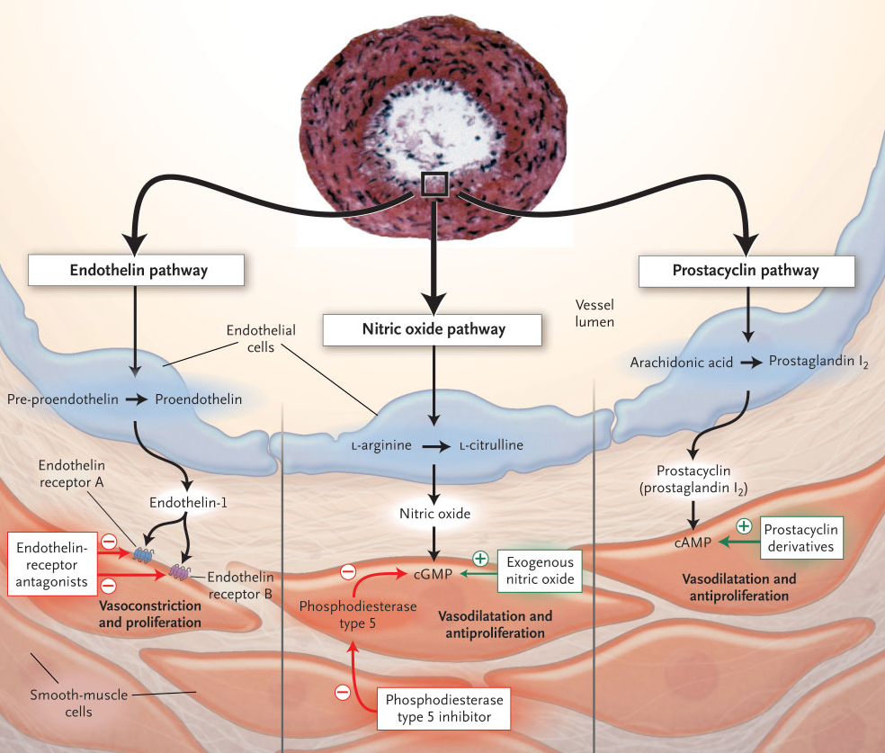
Pulmonary Vasodilators

Slide 35
How Do You Treat It?
Vasoactive medications
  Prostacyclins
    Epoprostenol (synthetic prostacyclin (PGI2) aka Flolan®)
    Treprostinil (Remodulin®), Iloprost (Ilomedin®, Ventavis®)
  Endothelin receptor antagonists
    Bosentan (Tracleer®), Sitaxsentan (Thelin®), Ambrisentan (Letairis®)
  Phosphodiesterase type 5 inhibitors
    Sildenafil (Revatio®), Tadalafil (Cialis®)
Notes:
No IV vasodilator is completely specific to pulmonary circulation
PDE5 normally decreased cGMP so its inhibitors prevent degradation of cGMP
Also think digoxin, atrial septostomy, coumadin, diuretics, CCBs

Slide 36
Inhaled Nitric Oxyde
Dilate pulmonary vessels in ventilated units of the lung
Reverses hypoxic pulmonary vasoconstriction
In acutely decompensated RV improves PVR, increase CO improve PaO2/FiO2 (Benker KA et Al. Am J Crit Care. 1997 Mar;6(2):127-31)
Beware of methemoglobinemia (high concentraton, prolonged use)

Slide 37
Prostanoids
Intravenous Epoprostenol
Effect on survival in stable patients with PAH
Reduces mPAP and improves CO
Systemic side effects
Worsening PaO2/FiO2
Systemic effects (hypotension)
Inhaled prostacyclin / nebulized iloprost: case series (Shock associated with PAH, Olschewski H. Intensive Care Med. 1998 Jun;24(6):631-4)

Slide 38
Sidenafil
Phosphodiesterase-5 inhibitor
Approved for treatment of PAH (stable patients)
Only case reports for use in critically ill (RVF after transplant: De Santo LS et Al.Transplant Proc. 2008 Jul-Aug; 40(6): 2015-8)
May be useful for weaning from inhaled nitric oxyde
Effect start 15mn after administration, peak effects within 30-60mn
Systemic hypotension

Slide 40
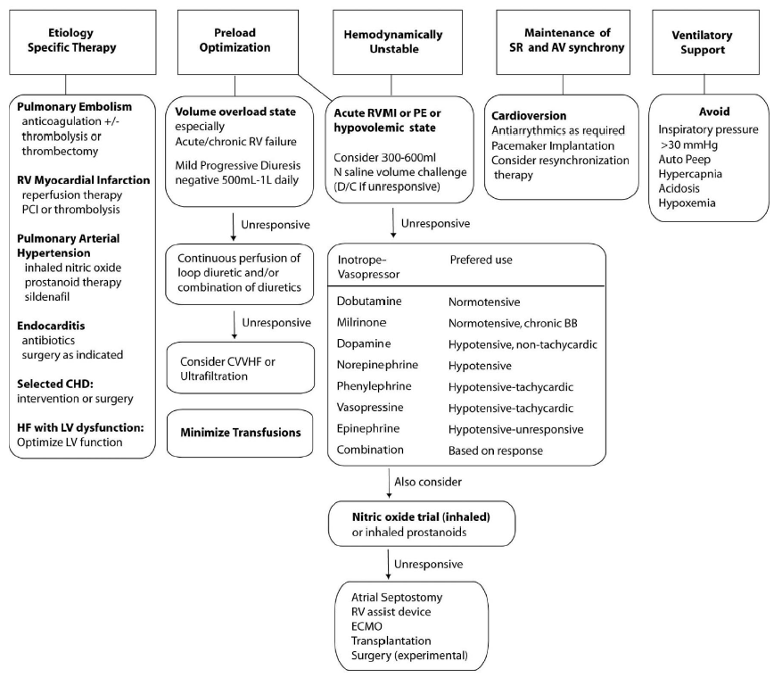
Haddad F, MD; Circulation. 2008;117:1717-1731

Slide 41
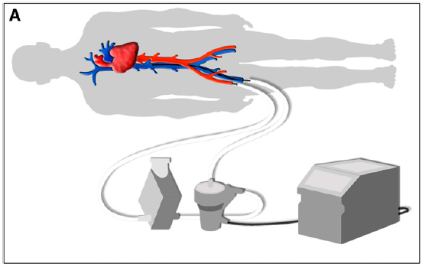
Veno-Arterial Extracorporeal Membrane Oxygenation (v/a ECMO)

Slide 42
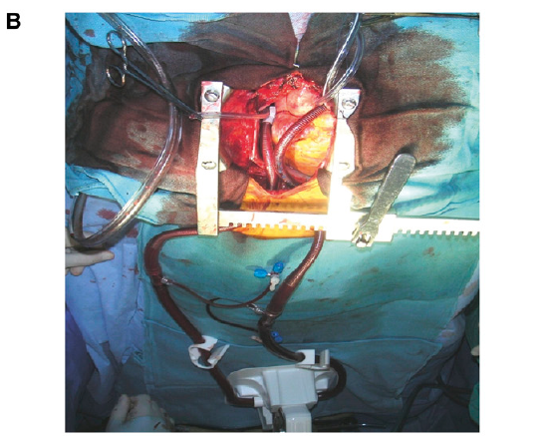
(V/A ECMO) 2
The Circuit is Between PA and LA

Slide 43


